Slide 1
Abaqus Python
Abaqus Python Scripting
Learn with the concepts
Lec 3 – Where to Start

Slide 2
Content:
Abaqus/CAE Python Integration
Replay file
Journal file
Recovery file
Entity selection commands
Abaqus python scripting guide

Slide 3
Abaqus/CAE Python Integration
Abaqus/CAE
GUI
Command Line Interface (CLI)
Script
commands
Python Interpreter
Replay files
Brain of Abaqus/CAE
Abaqus/CAE kernel

Slide 4


Replay file
You can recreate the model using replay file.
When you start a session, Abaqus creates ‘abaqus.rpy’ file.
Abaqus/CAE or Viewer
abaqus.rpy
All Abaqus/CAE actions are recorded in replay file in the form of Abaqus Scripting Interface commands.
Modify model
Rotate the model
Change viewport background colour
Change ODB display contour
Modify ODB data
abaqus.rpy
abaqus.rpy.4
abaqus.rpy.3
abaqus.rpy.2
abaqus.rpy.1
abaqus.rpy
abaqus.rpy.5
abaqus.rpy.4
abaqus.rpy.3
abaqus.rpy.2
ONLY 5 recent versions of replay file will be retained.

Slide 5
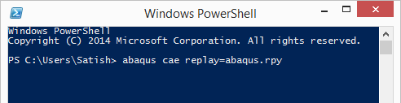
Replay file
You can execute the commands in a replay file as follows:
1
Is error occurred?
YES
ignore
NO
Continue
Is error occurred?
YES
STOP Execution
2
File ➔ Run Script
NO
Continue

Slide 6
Journal file
If the model database becomes corrupted, you can recreate the model using journal file.
When you save the model database, Abaqus/CAE saves the journal file.
File ➔ Save as
<model_database_name>.jnl
The model database journal file contains only the commands that change the saved model database.
Modify model
Rotate the model
Change viewport background colour
Change ODB display contour

Slide 7
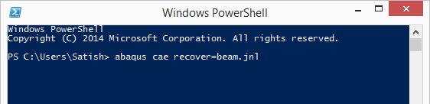
Journal file
You can execute the commands in a journal file as follows:

Slide 8
Recovery file
The recovery file stores the unsaved model database commands.
Create and make changes
Recovery file created:
abaqus1.rec
Save model beam.cae
Create beam.cae and beam.jnl
&
Delete abaqus1.rec
make further changes
Create beam.rec
Save model beam.cae
Append data from beam.rec to beam.jnl
&
Delete beam.rec

Slide 9
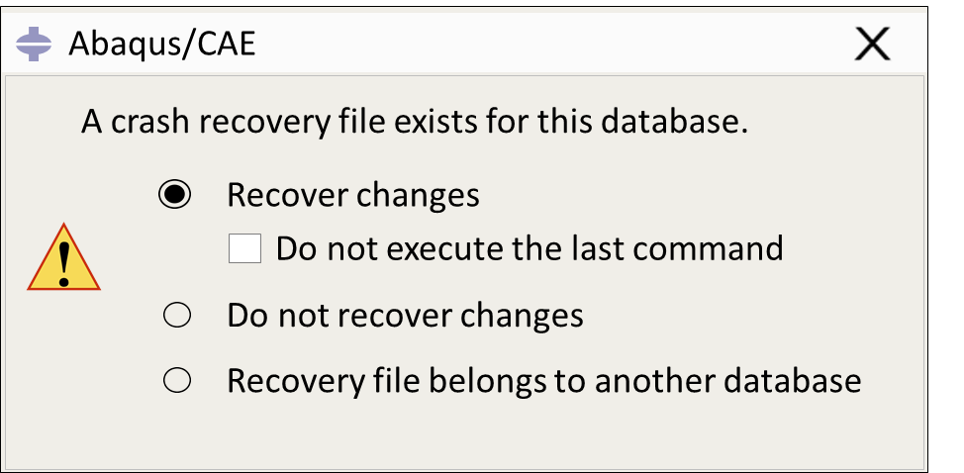
Recovery file
Consider your Abaqus/CAE session aborts unexpectedly!
Recovery file created:
abaqus1.rec
Session opened again
Create and make changes
Abaqus/CAE closed abruptly
Prompt to user
YES
Is recovery file exists?
NO
Continue

Slide 10
Recovery file
Consider your Abaqus/CAE session aborts unexpectedly!
Recovery file created:
beam.rec
Session opened again
make changes to beam.cae
Abaqus/CAE closed abruptly
Open beam.cae
Prompt to user
YES
Is recovery file exists?
NO
Continue

Slide 11
Entity selection commands
By default, Abaqus uses ‘getSequenceFromMask’ command for entity selection.
These are internal commands and not human readable.
allCells = mdb.models['Model A'].parts['rect_beam'].cells
Selected_cells = allCells.getSequenceFromMask(mask=('[#1 ]', ), )
To do this, we must change the journaling options:
COORDINATE
INDEX
COMPRESSEDINDEX
findAt() & getClosest()
Use entity index
getSequenceFromMask()
session.journalOptions.setValues()
replayGeometry & recoverGeometry
Values ➔ COORDINATE, INDEX & COMPRESSEDINDEX.
session.journalOptions.setValues(replayGeometry= COORDINATE,
recoverGeometry= COORDINATE)

Slide 12
Next Session
Lec 4 – Abaqus Data Types
Abaqus python scripting guide
Abaqus Scripting Interface data types
SymbolicConstants
Boolean
Repositories
Importing modules

